Slide 1
NAME: VISHWA CHATURVEDI
ENROLLMENT NO. : 201806100110127
CLASS : 4TH YEAR
SEMESTER: 7TH
SUBJECT : WIRELESS NETWORK

Slide 2
Hotel Room card scanner

Slide 3
DEFINITION:
The RFID card replaces the standard lock-and-key system for entry. You place the card on or near the reader, the reader identifies the signal as belonging to an authorized user, and the door unlocks. RFID is a method of data collection that involves automatically identifying objects through low-power radio waves. Data is sent and received with a system consisting of RFID tags, an antenna, an RFID reader, and a transceiver.

Slide 4
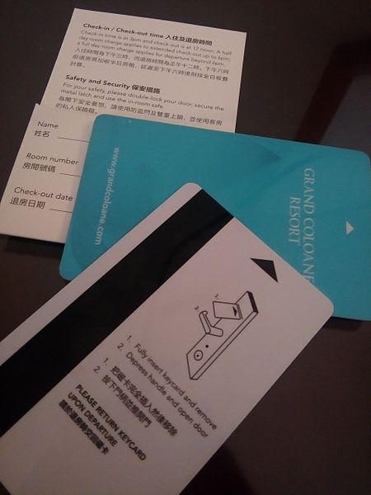
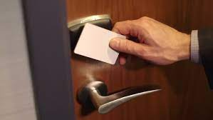

Slide 5
INTRODUCTION:
Radio-frequency identification (RFID) uses electromagnetic fields to automatically identify and track tags attached to objects. An RFID system consists of a tiny radio transponder, a radio receiver and transmitter. When triggered by an electromagnetic interrogation pulse from a nearby RFID reader device, the tag transmits digital data, usually an identifying inventory number, back to the reader. This number can be used to track inventory goods.
Passive tags are powered by energy from the RFID reader's interrogating radio waves. Active tags are powered by a battery and thus can be read at a greater range from the RFID reader, up to hundreds of meters.

Slide 6
Unlike a barcode, the tag does not need to be within the line of sight of the reader, so it may be embedded in the tracked object. RFID is one method of automatic identification and data capture (AIDC).RFID tags are used in many industries.
For example, an RFID tag attached to an automobile during production can be used to track its progress through the assembly line, RFID-tagged pharmaceuticals can be tracked through warehouses, and implanting RFID microchips in livestock and pets enables positive identification of animals. Tags can also be used in shops to expedite checkout, and to prevent theft by customers and employees.

Slide 7
Since RFID tags can be attached to physical money, clothing, and possessions, or implanted in animals and people, the possibility of reading personally-linked information without consent has raised serious privacy concerns. These concerns resulted in standard specifications development addressing privacy and security issues.

Slide 8
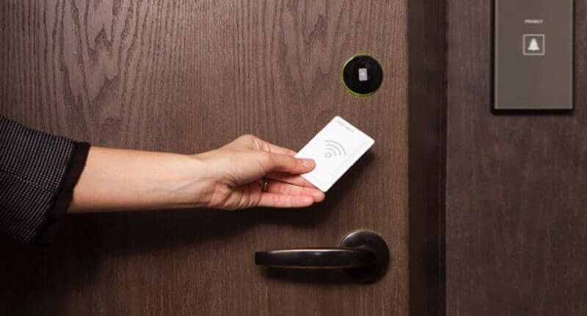
WORKING:

Slide 9
WORKING:
Like barcode technology, RFID Scanner recognizes locations and identification of tagged items — but instead of reading laser light reflections from printed barcode labels, it leverages low-power radio frequencies to collect and store data. In a warehouse or distribution center, this technology is used to automate data collection. The transceiver reads radio frequencies and transmits them to an RFID tag. The identification information is then transmitted from a tiny computer chip embedded in the tag and broadcasted to the RFID reader.

Slide 10
FRATURES AND FUNCTIONS
Here are a few of RFID’s helpful features and functions:
Tags can trigger alarms when moved Communication between readers and tags is not contingent upon orientation Data can be automatically read and stored Tags can carry unique or standardized product codes Items can be individually labeled, but read in mass Tag data is compatible with WMS and ERP systems Tags are difficult to reproduce/counterfeit

Slide 11
USES:
USED:
An RFID tag can be affixed to an object and used to track tools, equipment, inventory, assets, people, or other objects.
RFID offers advantages over manual systems or use of barcodes. The tag can be read if passed near a reader, even if it is covered by the object or not visible. The tag can be read inside a case, carton, box or other container, and unlike barcodes, RFID tags can be read hundreds per second; barcodes can only be read one at a time using current devices. Some RFID tags, such as battery-assisted passive tags, are also able to monitor temperature and humidity.

Slide 12
RFID can be used in a variety of applications such as:
Access management
Tracking of goods
Tracking of persons and animals
Toll collection and contactless payment
Machine readable travel documents
Smartdust (for massively distributed sensor networks)Locating lost airport baggage
Timing sporting events
Tracking and billing processes
Monitoring the physical state of perishable goods

